Slide 1
Healthy Plate App and Responsive Website
Kristina Dunai

Slide 2

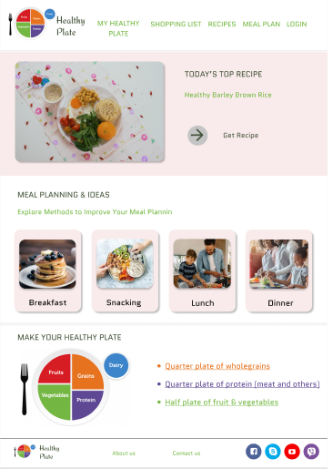
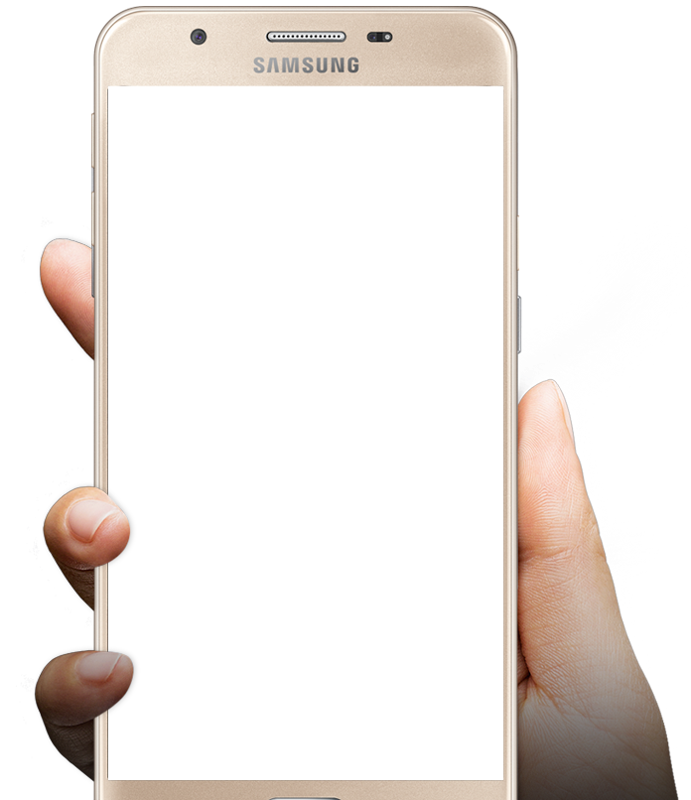
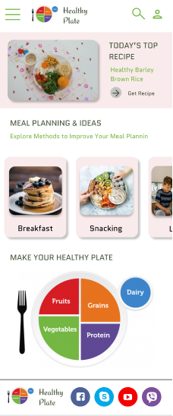
Project overview
The product:
Healthy Plate is a Croatia-based organization focused on healthy food. The organization needs a tool that helps people learn about healthy diet and making simple meals for their kids. Healthy Plate’ primary target users include busy parents who are concerned with healthy diet.
Project duration:
November 2021

Slide 3
Project overview
The problem:
Proper nutrition is a prerequisite for a child's health. Unlike adults, children grow and develop intensively physically, intellectually and mentally, so in addition to the basic needs for energy, nutrition must also provide enough for growth and development. Poor nutrition, quantity or quality can have negative consequences on the fulfillment of the genetic potential for growth, mental development and delays in pubertal development. In addition, it is now known that the diet at an early age has repercussions and on health in adulthood.
The goal:
Design an app that will improve education on the topic of healthy food and home cooking.

Slide 4
Project overview
My role:
UX designer leading the app and responsive website design from conception to delivery
Responsibilities:
Conducting interviews, paper and digital wireframing, low and high-fidelity prototyping, conducting usability studies, accounting for accessibility, iterating on designs, determining information architecture, and responsive design.

Slide 5
User research
Personas
Problem statements
Competitive audit
Ideation
Understanding
the user

Slide 6
User research: summary
I used Healthy Plate’s data on healthy food to develop interview questions, which were then used to conduct user interviews. Most interview participants reported feeling concerned about the unhealthy diet of their children and do not know how to start and create healthy habits. The feedback received through research made it very clear that users would be open and willing to work towards cooking healthy meals at home if they had access to an easy-to-use tool to help guide them.

Slide 7
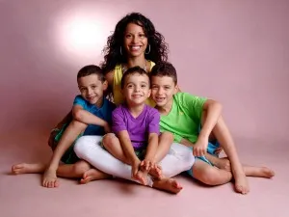
“As a mom to three boys that are getting older by the day, I find myself constantly wading through the challenge of teaching them about nutrition”
Goals
She wants her kids to think and grow up and have respect for their bodies, to make wise choices about the foods they eat.
Frustrations
Difficulty explaining nutrition concepts like what is saturated fat
Confused how to cook healthily to family members
Ana
Ana is 42 year old mom who thinks that kids are bombarded with junk food all the time, and unless you’re living on a remote isolated commune in the middle of nowhere, it’s just about impossible to avoid it. Kids will see other people eating these foods. They will be given these foods, they will like them, and want more of them.
She thinks that in our best efforts to educate them, when we label foods as bad, unhealthy, or junk, then we could make them feel bad about themselves for enjoying it, and we also set the stage for a classic parent-child power struggle.
She wants to learn her three boys about healthy diet without pressure.
Age:
Education:
Hometown:
Family:
Occupation:
42
Textile school
Croatia, Osijek
3 kids and spouse
Housewife

Slide 8

“I want to teach my child a healthy diet.”
Goals
Prepare delicious and healthy meals and snacks with minimal throwing
Teaching kids about nutrition without having the reverse effect
Frustrations
She thinks that there is a very wrong way to teach our kids about nutrition, especially parents of picky eaters, because they are so worried that they aren’t getting the vitamins and nutrients they need to grow and learn.
Add image that represents this persona
Alisha
Alisha is busy mom who works full time job and wants to prepare healthy food for her familiy. She has a child who is picky eater and worries that she is eating unhealthily.
She is aware that world is filled with weekly treats at school, junk food from well-meaning family members, and manipulating commercial marketing that influences kids to want more candy and food with all sorts of artificial ingredients.
She wants to teach her child a healthy diet.
Age:
Education:
Hometown:
Family:
Occupation:
38
Economy
Croatia, Dubrovnik
Child and spouse
Procurement Spec.

Slide 9
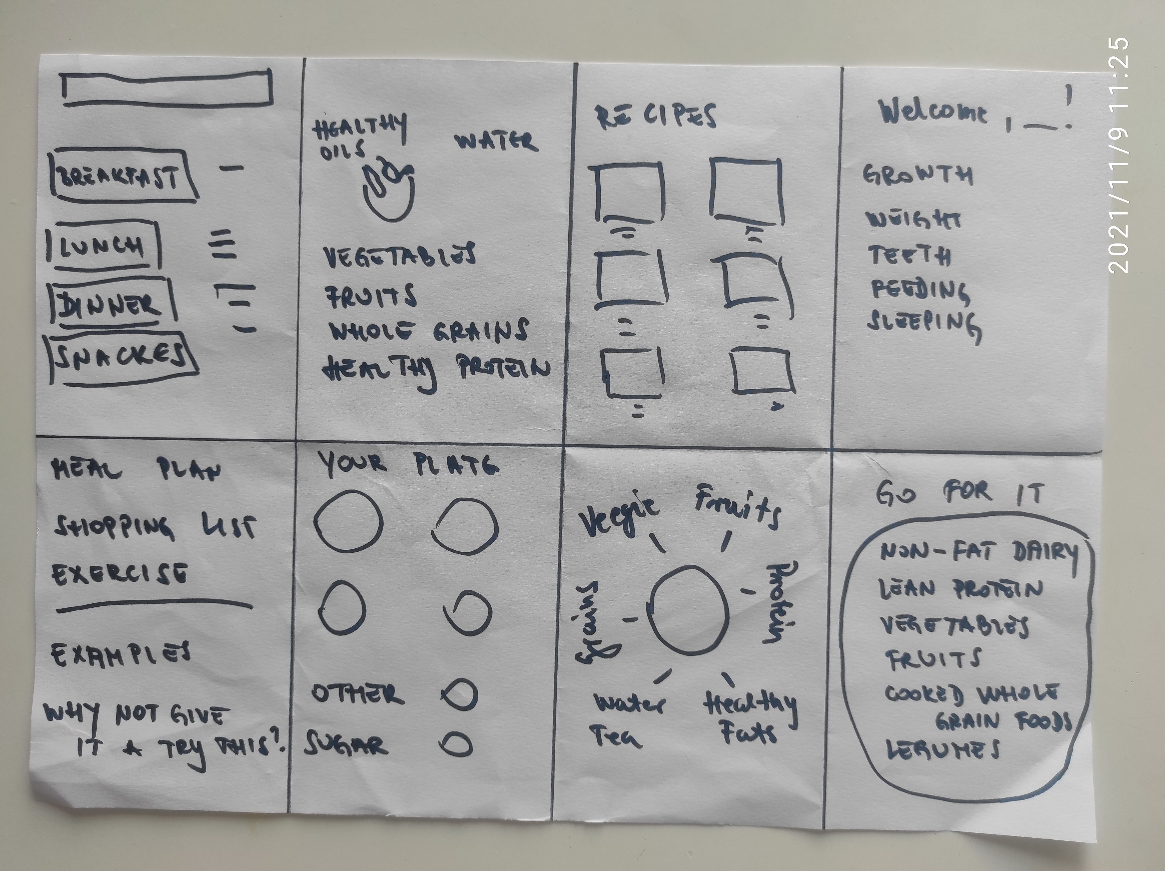
Ideation
I did a quick ideation exercise to come up with ideas for how to address gaps identified in the competitive audit. My focus was specifically on simple recipe features.

Slide 10
Digital wireframes
Low-fidelity prototype
Usability studies
Starting
the design

Slide 11
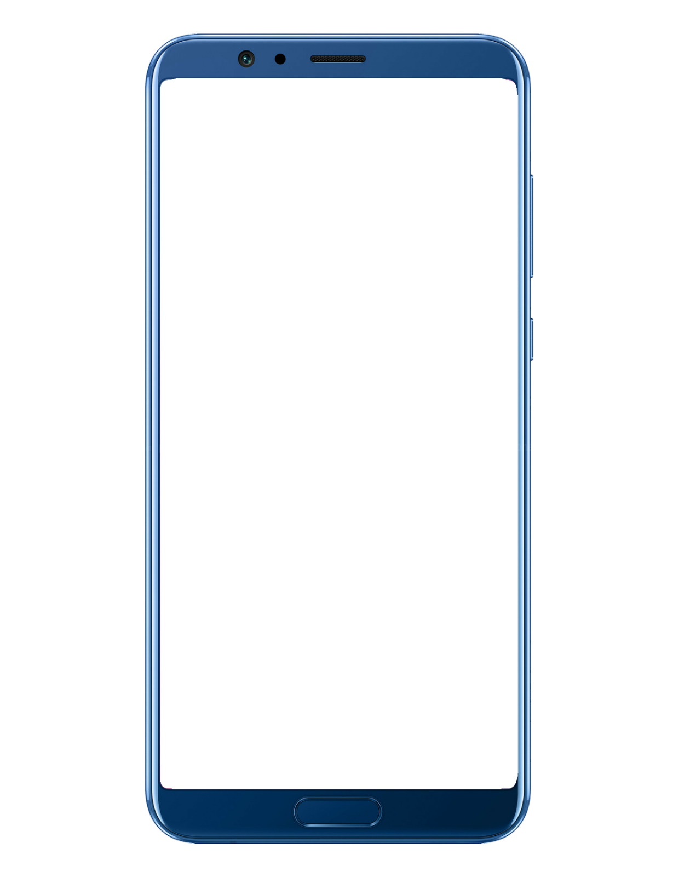
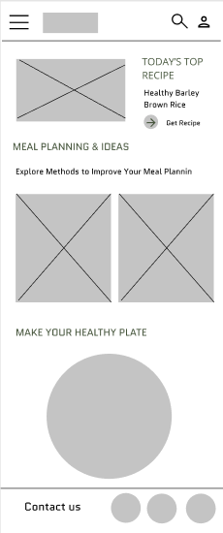
Digital wireframes
Top half of home screen acts like a food coach by providing personalized recommendations for users
After ideating and drafting some paper wireframes, I created the initial designs for the Healthy Plate app. These designs focused on delivering personalized guidance to users to help manage their food.
Easy access to app features from global navigation

Slide 12
Usability study: parameters
Study type:
Unmoderated usability study
Location:
Croatia, remote
Participants:
7 participants
Length:
30-60 minutes

Slide 13
Usability study: findings
These were the main findings uncovered by the usability study:
1
2
3
Recipes
Quick Meals
Login
People want easy access to recipes that specifically use the food they already own.
People had difficulty finding quick meals.
People want to login and save they favorite recipes.

Slide 14
Refining
the design
Mockups
High-fidelity prototype
Accessibility

Slide 15
Before usability study
After usability study
Mockups
Additional design changes included adding an option to “Today’s Top Recipe” on the top of screen, and providing a clearer navigations to meal planning.

Slide 16
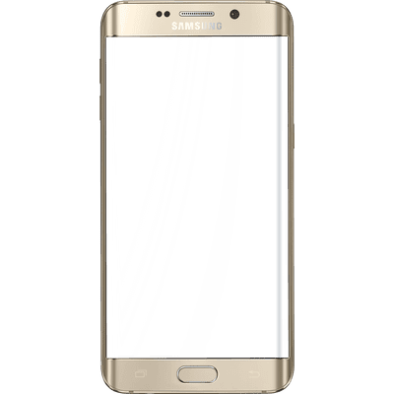
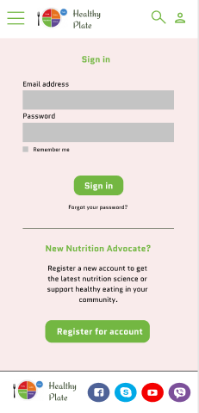
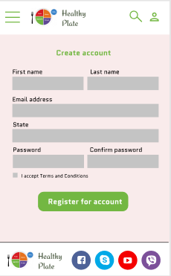
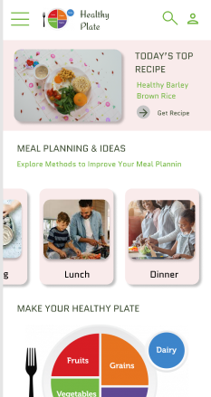
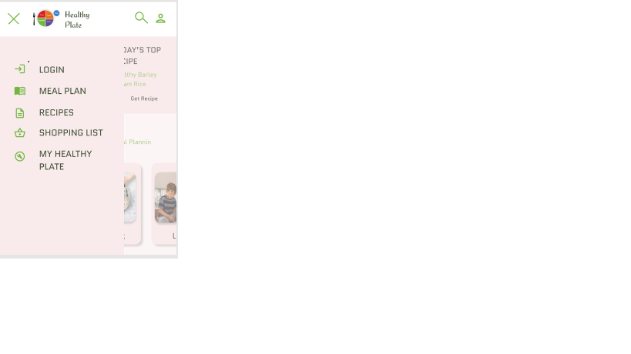
Mockups

Slide 17
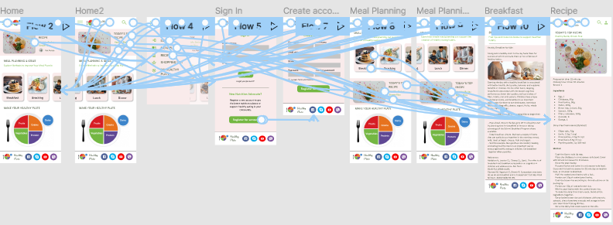
High-fidelity prototype
The high-fidelity prototype followed the same user flow as the low-fidelity prototype, including design changes made after the usability study.

Slide 18
Accessibility considerations
1
2
Clear labels for interactive elements that can be read by screen readers.
Initial focus of the home screen on personalized recommendations help define the primary task or action for the user.

Slide 19
Responsive Design
Information architecture
Responsive design

Slide 20
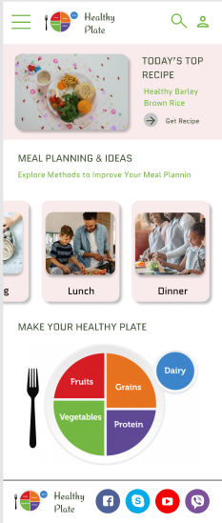
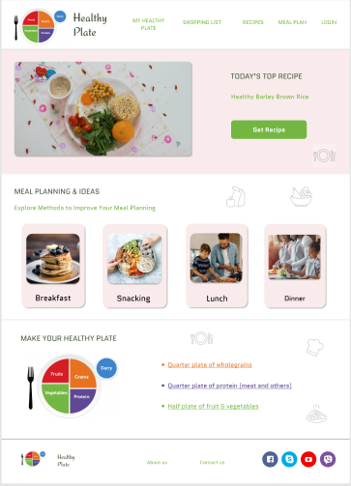
Responsive designs
Mobile website
Tablet
Desktop
The designs for screen size variation included mobile, tablet, and desktop. I optimized the designs to fit specific user needs of each device and screen size.

Slide 21
Going forward
Takeaways
Next steps

Slide 22
Takeaways
Impact:
Users shared that the app help them to cook healthier. One quote from peer feedback was that “The Healthy Plate app helps prepare delicious and healthy meals and snacks with minimal throwing. It teaches kids about nutrition without having the reverse effect.”
What I learned:
I learned that even though the problem I was trying to solve was a big one, diligently going through each step of the design process and aligning with specific user needs helped me come up with solutions that were both feasible and useful.

Slide 23
Next steps
1
2
3
Conduct research on how successful the app is in reaching the goal to cooking healthier meals at home.
Add more educational resources for users to learn about healthy food.
Provide incentives and rewards to users for successfully adopting healthy habits.

Slide 24
Let’s connect!
Thank you for your time reviewing my work on the Healthy Plate app! If you’d like to see more or would like to get in touch, my contact information is provided below.
Email: dunaikristina@gmail.com
Website: https://sites.google.com/view/kristinasportfolio/my-work

